Slide 1









Welcome
Georgia Milestones Assessment Training
March 28, 2016
Presented At
T.W. JOSEY HIGH SCHOOL
T. W. Josey
Wilkinson
Alternative
Gardens
Wheeless
Jenkins White

Slide 2



INSPIRATION for the
BEST Parents, Faculty and Staff
Wheeless

Slide 3

Richmond County Beliefs & Goals
PURPOSE of GA Milestone
TEST SCHEDULE

Slide 4

The Mission of the Richmond County School System is to educate students to become lifelong learners and productive citizens.
RCSS Belief Statements
1. Every person has the right to a quality education.
2. Education is the shared responsibility of the individual, home, school, and community.
3. Every person can learn.
4. Respect and acceptance are essential for learning and personal development.
5. A safe, healthy and orderly environment is essential to learning.
6. Communication is the key to understanding among people.
7. Excellence cannot be compromised.

Slide 5
District Strategic Goals
Guarantee High Academic Achievement for All
Ensure Communication and Collaboration within the Community
Provide a Safe, Orderly, and Healthy Learning Environment
District Focus
Students on track in Reading by end of 3rd grade
Students on track in Mathematics by end of 4th grade
Increase Graduation Rate for all students

Slide 6

Purpose of the Georgia Milestones Assessment System
To improve student achievement by providing information that guides and plans for improving learning.

Slide 7

Information Provided by Georgia Milestone Assessment
An official measure of individualized student accomplishment of achieving the learning expectations for his/her grade level
Information on students’ readiness for the next grade level
A measurement of how much progress is made from one grade level to the next
Information on teacher effectiveness
Information on school, district, and state accountability: is what students know, and are able to do, in line with the expectation of what needs to be taught (Georgia Standards of Excellence)

Slide 8


Goal of the Georgia Milestone Assessments System?
The goal is to ensure that all students are provided the opportunity to engage with high-quality content standards (a description of what students should know, and be able to do), receive high-quality instruction based on these standards, and are able to meet high academic expectations as measured by the Georgia Milestone assessment.

Slide 9

Georgia Milestones Assessments
EOG
The Georgia Milestones Assessments are a yearly End-of-Grade measure of student achievement taking place in grades 3rd-8th
English Language Arts (ELA)
Mathematics
Science
Social Studies
All students must participate in the assessments with the exception of students who qualify for GAA.
Notes:
All students must participate in the assessments with the exception of students who qualify for GAA.

Slide 10
Georgia Milestones TEST Schedule
EOG | April 18-22 | April 25-29
Elementary: | Grade 3 (paper) Grade 4 (online) Make ups for Grades 3 & 4 | Grade 5 (online) Make ups for Grades 3, 4, 5
Middle: | Grade 6 (paper) Grade 7 (online) Make ups for Grades 6 & 7 | Grade 8 (online) Make ups for Grades 6, 7, 8

Slide 11
Georgia Milestones Assessments - EOC
The Georgia Milestones Assessments are a yearly End-of-Course measure of student achievement taking place in 9th – 12th
English Language Arts (ELA)
  9th grade Literature (9TH )
  American Literature (11TH )
Mathematics
  Algebra 1 (9TH )
  Geometry (10TH )
Science
  Biology (9TH )
  Physical Science (10TH )
Social Studies
  US History (11TH )
  Economics (12TH )
All students must participate in the assessments with the exception of students who qualify for GAA.
Notes:
All students must participate in the assessments with the exception of students who qualify for GAA. High School students participate in up to 8 End-of-Course Georgia Milestones. Assessments. Some students may have passed high school courses in middle school.

Slide 12
Georgia Milestones TEST Schedule
EOC | May 2-6 | May 9-13
Monday | Algebra (paper) Economics (online) | Physical Science (online) Biology (online)
Tuesday | American Lit (Sections 1 & 2) (online) 9th Lit (paper) | Make ups for all parts
Wednesday | American Lit (Section 3) (online) 9th Lit (paper) | Make ups for all parts
Thursday | Geometry (online) US History (paper)
Friday | Make ups for Algebra, Econ, American Lit, 9th Lit, Geometry and US History

Slide 13
Assessment Parameters
T. W. Josey

Slide 14

General Test Parameters
ELA will consists of 3 sections, 1 of which will focus mainly on writing
Mathematics will consist of 2 sections
Science will consist of 2 sections
Social Studies will consist of 2 sections

Slide 15
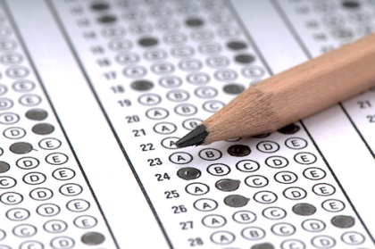

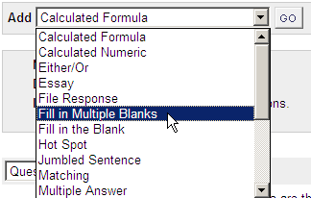
Georgia Milestones Question Types
Selected-Response [aka, multiple-choice]
      All content areas
      Evidence-based selected response in ELA
      Nationally norm-referenced items to provide a national comparison
Constructed-Response
      ELA and mathematics
Extended-Response
      ELA and mathematics
Technology Enhanced
      To begin in 2016-2017

Slide 16
Georgia Milestones Questions
Open Ended
Constructed-Response - ELA and mathematics
Extended-Response - ELA and mathematics
Assessment items that require the student to generate a response as opposed to selecting a response.
Assessment items require more elaborate answers and explanations of reasoning. They allow for multiple correct answers and /or varying methods of arriving at the correct answer. Writing prompts and performance tasks are examples of extended-response items.

Slide 17
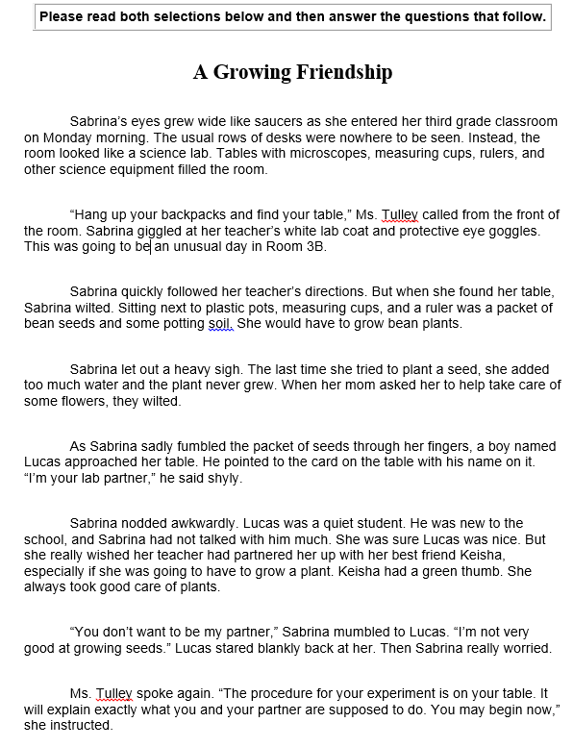
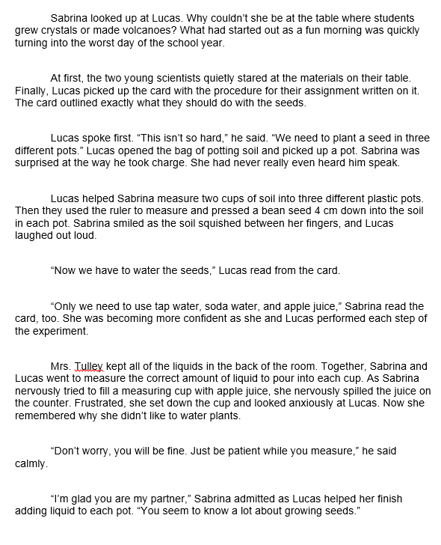
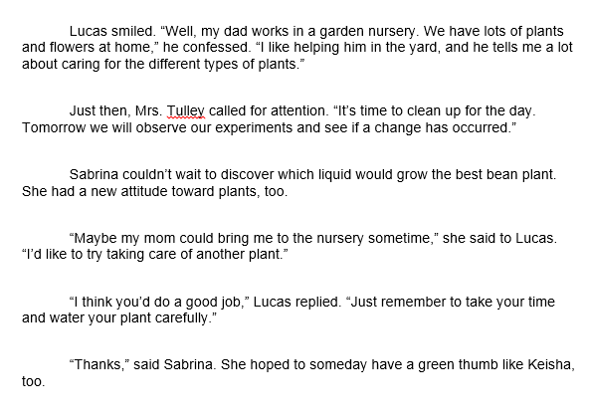
Sample 3rd grade Language Arts
Constructed Response Question

Slide 18
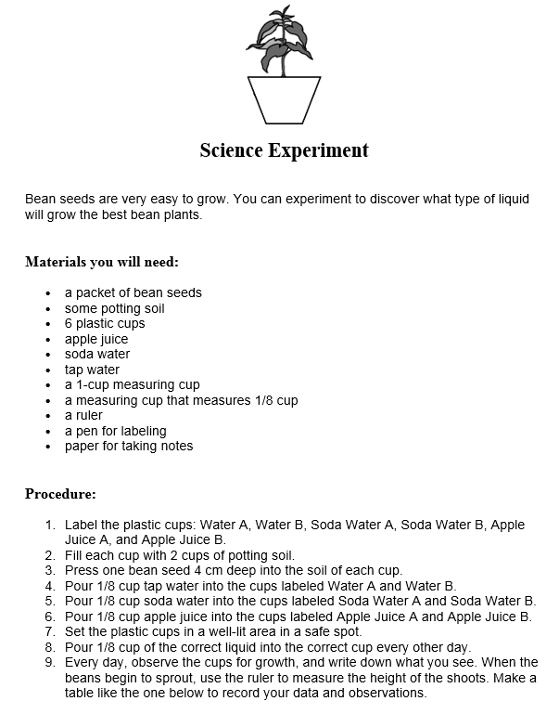
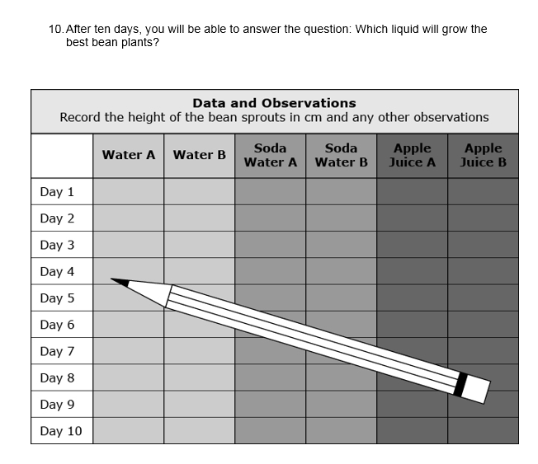
Sample 3rd grade Language Arts
Constructed Response Question

Slide 19
Sample 3rd grade Language Arts
Constructed Response Question
Explain why Sabrina felt nervous about doing something new. Use details from the story and your own personal experience to support your explanation.
(3.RL.1 Ask and answer questions to demonstrate understanding of a text, referring explicitly to the text as the basis for the answers.)
Explain how step 8 affects step 9 in “Science Experiment”. Use details from the article to explain why these steps are very important to making the experiment work.
(3.RI.3 Describe the relationship between a series of historical events, scientific ideas or concepts, or steps in technical procedures in a text, using language that pertains to time, sequence, and cause/effect.)
This task has more than one (1) part. Read each part carefully and respond.
Part A
Create a materials list that includes everything needed to complete steps one through six.
Part B
Using information from Part A and the directions in the “Procedure” section, answer these questions with a complete sentence.
How much of each of the materials should be in the cup labeled Water A after you have completed step six?
How much of each of the materials should be in the cup labeled Soda Water A after you have completed step six?
How much of each of the materials should be in the cup labeled Apple Juice A after you have completed step six?
(3.RI.8 Describe the logical connection between particular sentences and paragraphs in a text (e.g., comparison, cause/effect, first/second/third in a sequence).

Slide 20
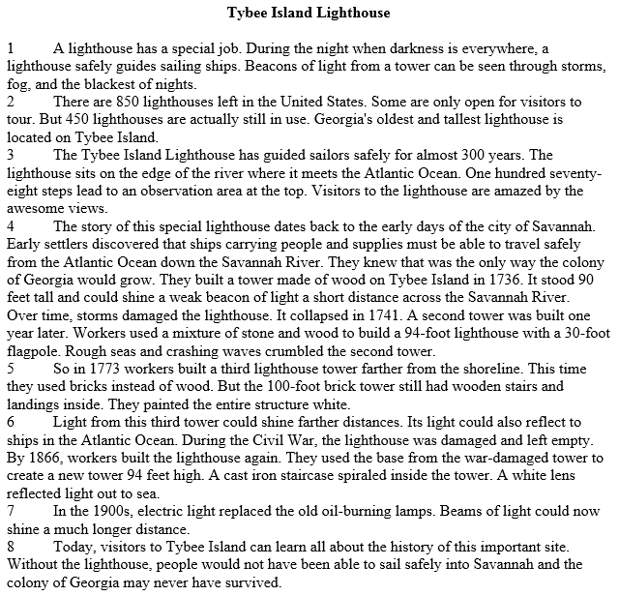
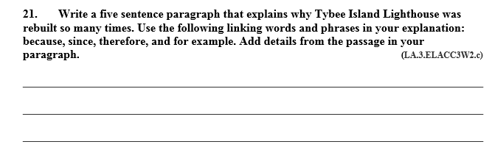
Sample 3rd grade Language Arts
Extended Response Question

Slide 21
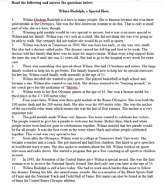
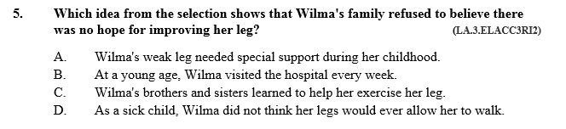
Sample 3rd grade Language Arts
Selected-Response Question

Slide 22
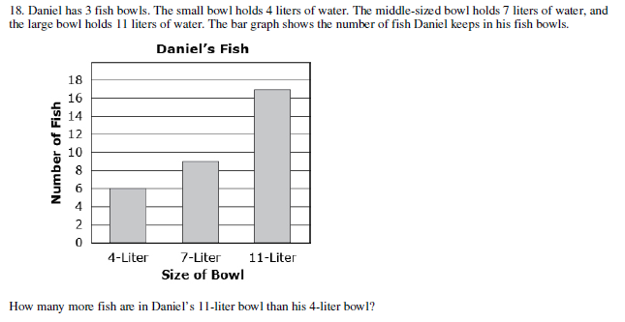
Sample 3rd grade Math
Constructed Response Question

Slide 23
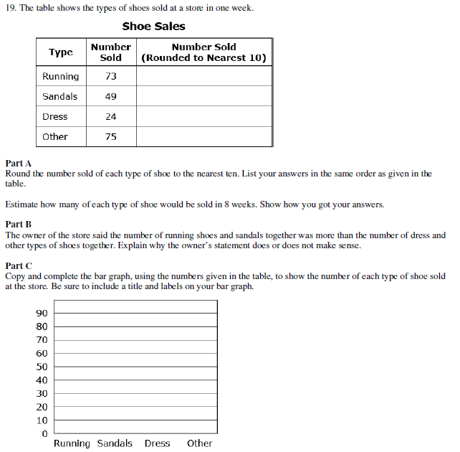
Sample 3rd grade Math
Constructed Response Question

Slide 24
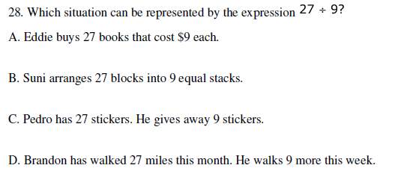
Sample 3rd grade Math Selected-Response Question

Slide 25
What can I do to help my child?
Have him/her write, write, and write some more!
Read, read, and read some more!
Always ask “why” and expect complete sentence answers.
Always prompt him/her to explain his/her thinking with pictures, words, and numbers.
Keep in contact with your child’s teacher.

Slide 26
What is school system doing to prepare your child?
Evidence-based writing focus (across content areas)
Using curriculum and planning resources provided by the GA Department of Education
Using sample items in instruction and on assessments
Participating in Practice Assessments beginning next month modeled after the Georgia Milestones sample assessment items
Practice EXTENDED Constructed Response prompts
Added Additional Computer time 3-5
Practice using Online assessments to mirror GMAS

Slide 27



Test Preparation/Study & Test Taking Strategies
Wilkinson
Gardens

Slide 28
Topics
Test Anxiety
Study Strategies
Test Taking Strategies
Self-Care

Slide 29
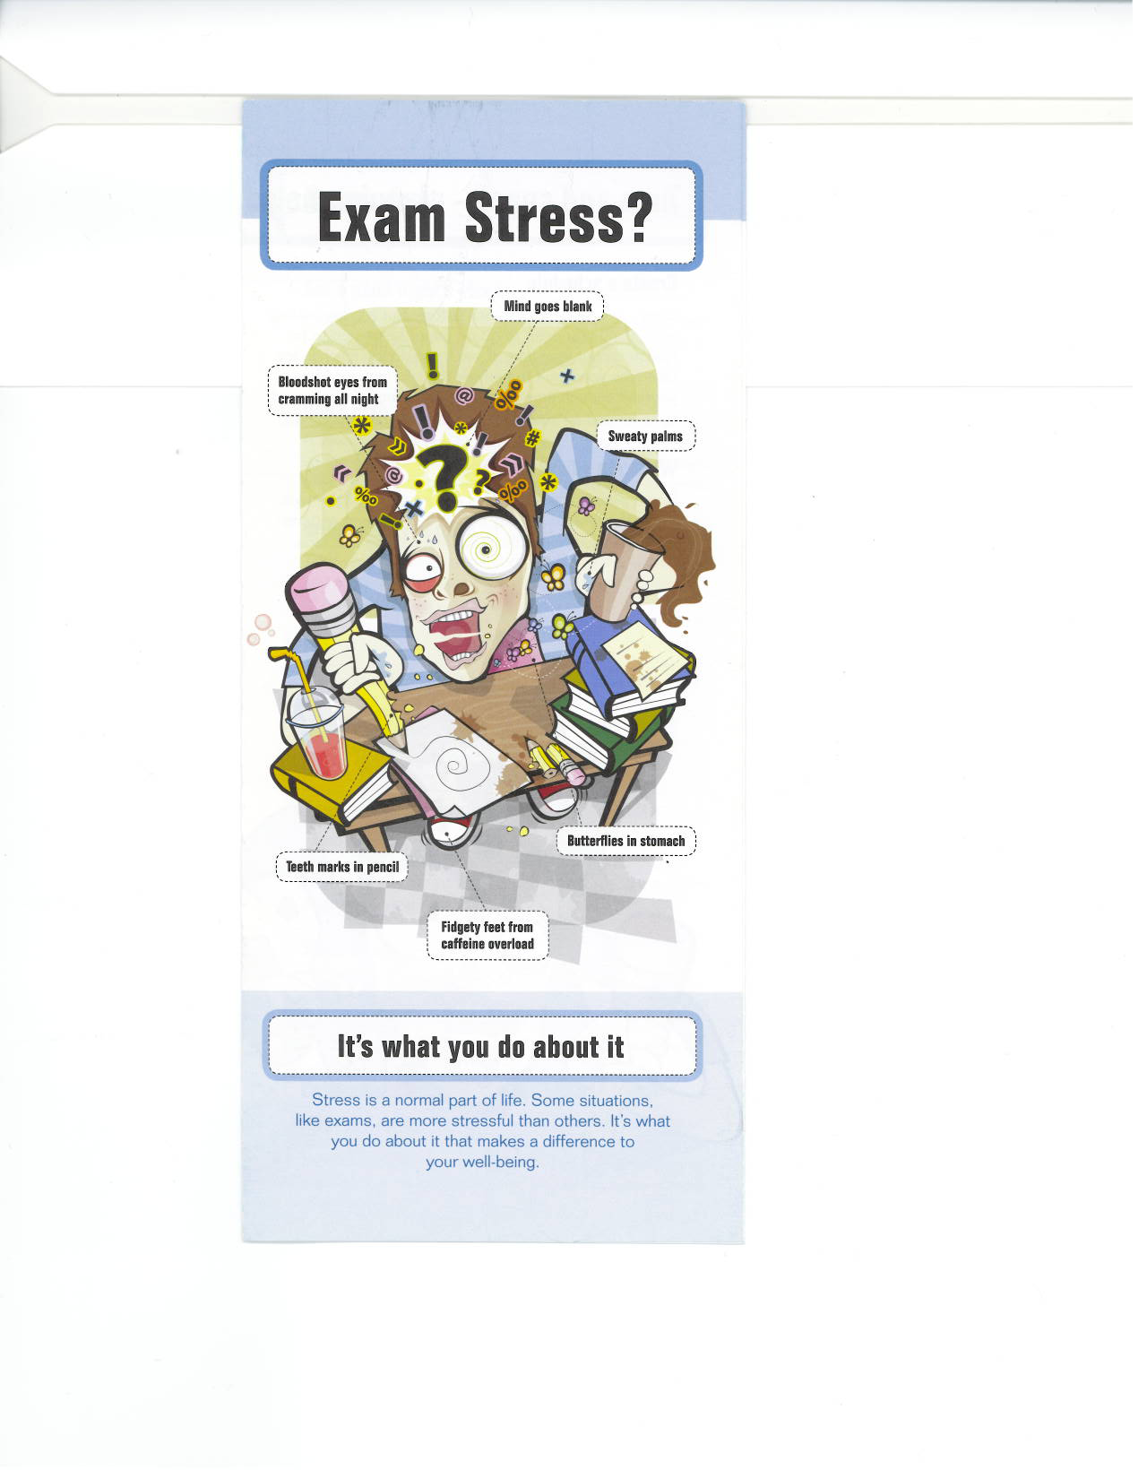

Slide 30
Reducing Test Anxiety
Mental Preparation
Physical Preparation
Relaxation Techniques

Slide 31
Mental Preparation
What to do before your exam:
  Be prepared
  Don’t Cram
  Arrive on time for school
  Eat BREAKFAST
  Get a good night’s sleep!
What to do during your exam:
  Be test wise and have a plan

Slide 32
Physical Preparation
What to do before your exam:
  Food – Eat
  Rest - Relax
What to do during your exam:
  Be comfortable
  Be aware of environment

Slide 33
Relaxation Techniques
Music
Breathing
Moment of Silence

Slide 34


Tips for Terrific
Test Taking

Slide 35


Analyze how you did on a similar test in the past
Review your previous tests, and sample tests.
Each test prepares you for the next.

Slide 36


Be on Time!
Before a test, list everything you need for it that is allowed
Know the schools current policies and expectations.

Slide 37
Be comfortable but alert
Choose a good spot in the room and make sure you have enough space to work.
Maintain a comfortable posture in your seat and don’t “slouch”.

Slide 38
Stay relaxed and confident
Relax
Keep a good attitude.
Remind yourself that you are well prepared and are going to do well.
If you find yourself anxious, take several slow, deep breaths to relax.
Don’t talk about the test to other students just before entering the room; anxiety is contagious.

Slide 39
Read the directions carefully
This may be obvious, but it will help you avoid careless errors.
READ
CAREFULLY

Slide 40
Answer questions in a strategic order:
Answer easy questions first.
Then answer difficult questions or those with the most point value.
With multiple choice first eliminate those answers you know to be wrong, or are likely to be wrong, don’t seem to fit, or where two options are so similar as to be both incorrect.
With essay/subjective questions, broadly outline your answer and sequence the order of your points.

Slide 41


Review
Resist the urge to leave as soon as you have completed the test. Review and make sure that you:
        Have answered all the questions
        Did not mis-mark answers
        Did not make simple mistakes
Proofread spelling, grammar, punctuation, decimal points, etc.

Slide 42
Change answers to questions if you made a mistake, or misread the question!
Or if you find information elsewhere in the test that indicates that your first choice is incorrect.
A
B

Slide 43

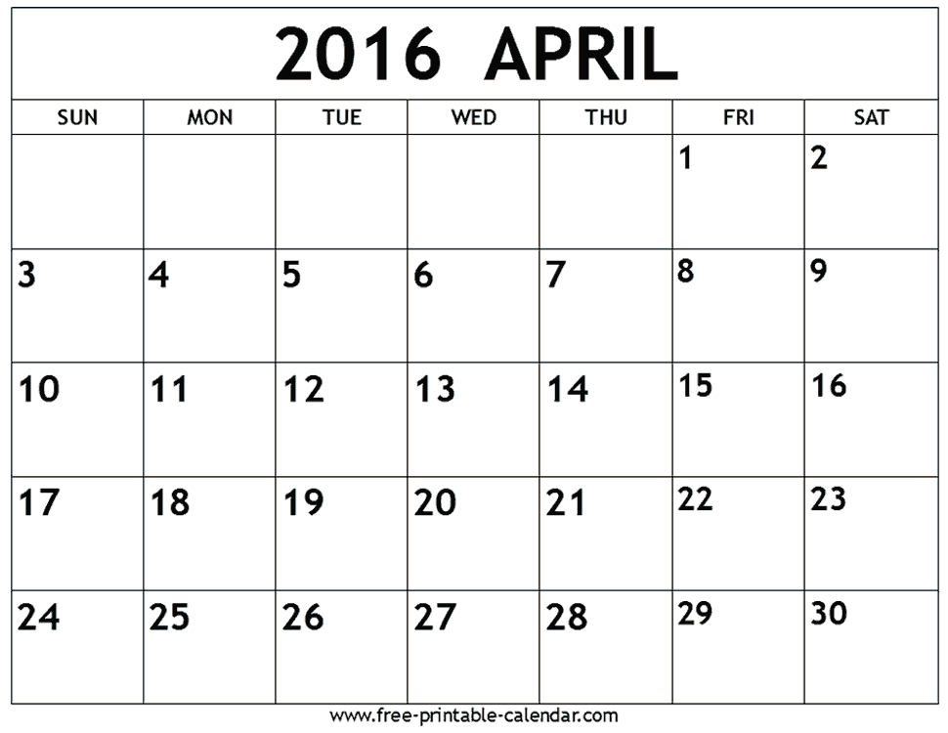
1. ORGANIZE YOURSELF – Have a Plan

Slide 44


2. Do Not Procrastinate to Study
- On the Phone
- Social Media
- Watching TV
- Hanging Out
Time waits for NO ONE!

Slide 45



3. Use Online Resources

Slide 46
4. Complete Study Guides and
Do Practice Exams

Slide 47
Assessment Results
Jenkins White

Slide 48

Georgia Milestones and Lexiles
GDOE issues Lexile measures
Students receive a Lexile measure along with their regular scale score for a Georgia Milestones End-of-Grade (EOG) or End-of-Course (EOC) English Language Arts (ELA) assessment.
A student’s Lexile measure is a score• for teachers to use in targeting reading material for students and for parents to use in selecting reading material for their children.

Slide 49

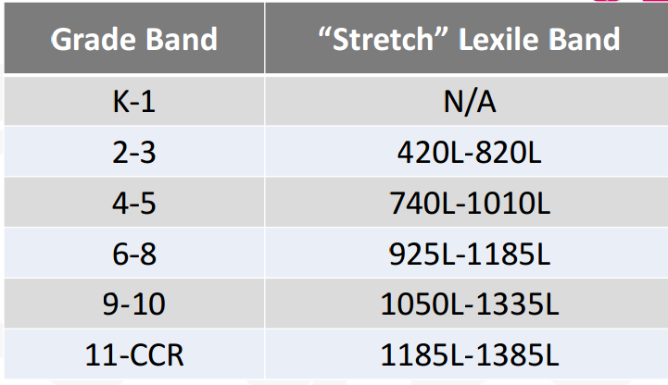
Lexile Scores
Required Lexile Score on grade level proficiency:
Grade 3: 650
Grade 4: 750
Grade 5: 850
Notes:
It is important that as a parent you know your child’s lexile level. These “stretch” Lexile bands are the basis for determining at what text complexity level students should be reading—and at which grades—to make sure they are ultimately prepared for the reading demands of college and career readiness

Slide 50

Individual Assessment Results
– Beginning Learners
– Developing Learners
– Proficient Learners
– Distinguished Learners
Notes:
Beginning Learners These students do not yet demonstrate proficiency (skills & abilities) in the knowledge and skills necessary as described in Georgia’s content standards (what students need to know & be able to do). Substantial academic support is needed for these students to be prepared for the next grade level.
Developing Learners Students demonstrate partial proficiency in the knowledge and skills necessary. These students need additional academic support to ensure success in the next grade. Proficient Learners These students demonstrate proficiency (meet expectations) in knowledge and skills expected at their grade level. Distinguished Learners These students demonstrate advanced proficiency in the knowledge & skills expected at their grade level. They are well prepared for their next grade!

Slide 51

Georgia Milestone: Promotion and Retention Policy/ Procedures:
Determines promotion/retention status in
Grade 3 (reading only),
Grade 5 (reading and mathematics)
Grade 8 (reading and mathematics)
Reading: a student who has a Below Grade Level Reading status will require remediation and retesting in ELA
Mathematics: a student who is classified as a Beginning Learner will require remediation and retesting in mathematics

Slide 52
Individual Assessment Results - EOC
– Beginning Learners (67% and Below)
– Developing Learners (79% to 68%)
– Proficient Learners (80% to 91%)
– Distinguished Learners (92% to 100%)
Notes:
Beginning Learners These students do not yet demonstrate proficiency (skills & abilities) in the knowledge and skills necessary as described in Georgia’s content standards (what students need to know & be able to do). Substantial academic support is needed for these students to be prepared for the next grade level.
Developing Learners Students demonstrate partial proficiency in the knowledge and skills necessary. These students need additional academic support to ensure success in the next grade. Proficient Learners These students demonstrate proficiency (meet expectations) in knowledge and skills expected at their grade level. Distinguished Learners These students demonstrate advanced proficiency in the knowledge & skills expected at their grade level. They are well prepared for their next grade!

Slide 53
What’s at stake this year??
The End of Course (EOC) measures serve as the final exam and comprise 20% of a student’s final course grade.
Students can not receive a credit for a course without taking the EOC.

Slide 54
Helpful Resources
http://www.gadoe.org/Curriculum-Instruction-and-Assessment/Assessment/Pages/Georgia-Milestones-Assessment-System.aspx
http://learnoas.ctb.com/GA/
YOUR SCHOOL’S WEBPAGE

Slide 55
TEST PRACTICE
T. W. Josey

Slide 56

Sample Online Assessment
Use the following link to access the site:
https://wbte.drcedirect.com/GA/portals/ga
Note that no login is required. All you need to do to access a test is to click on the login button to begin your experience.

Slide 57
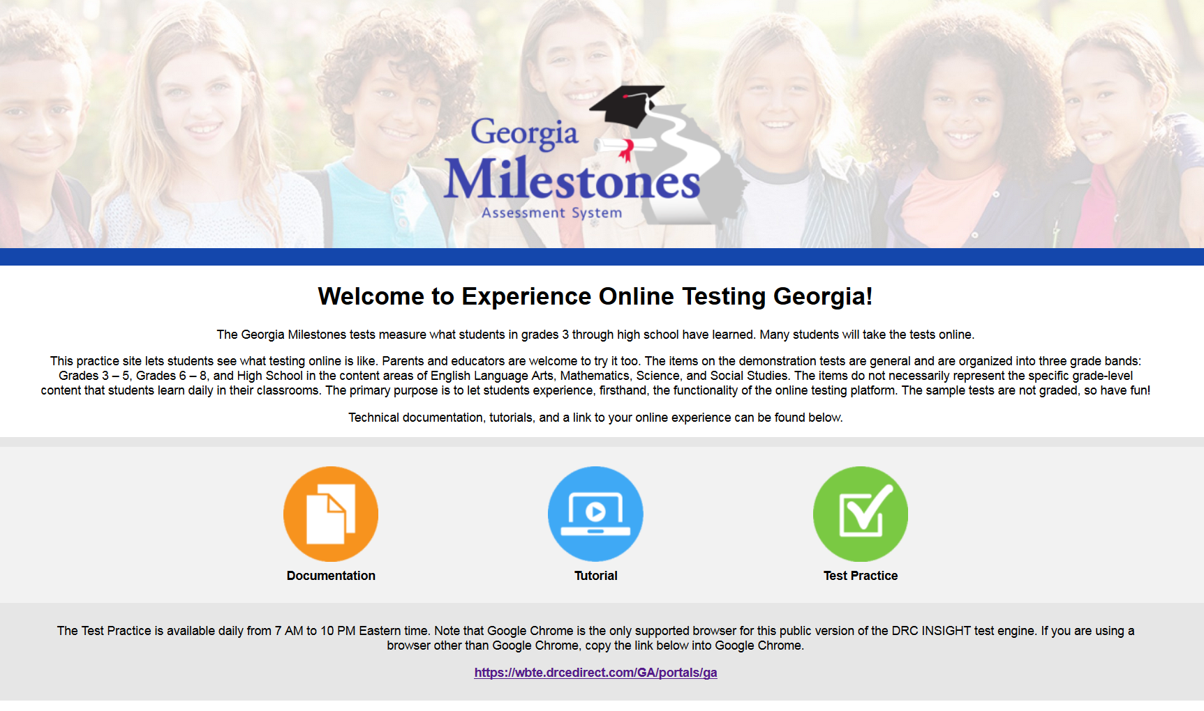
**Make sure to use Google Chrome ONLY!
www.gaexperienceonline.com

Slide 58
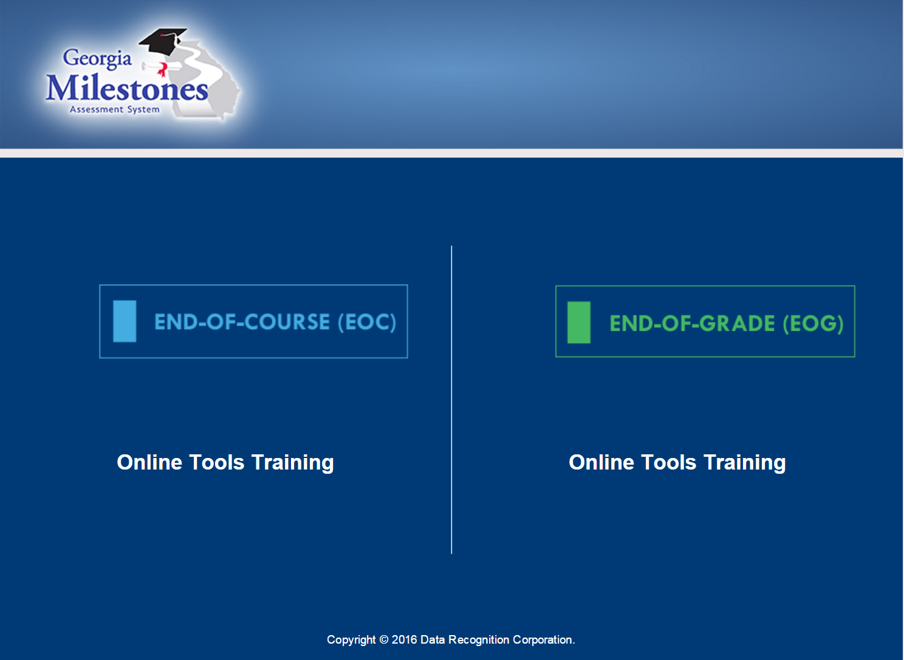

Slide 59


Slide 60
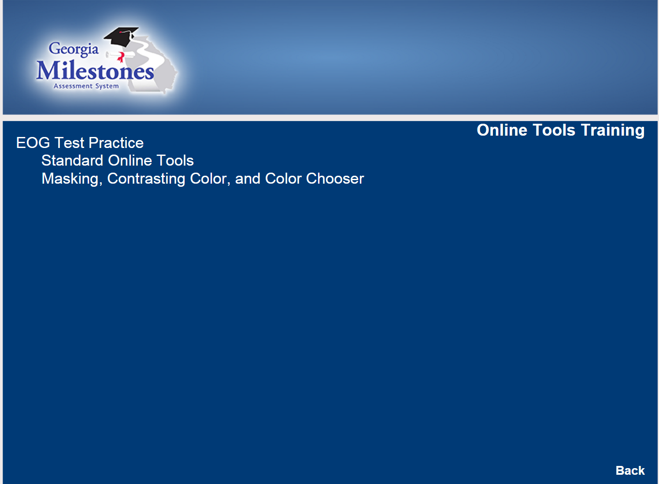

Slide 61
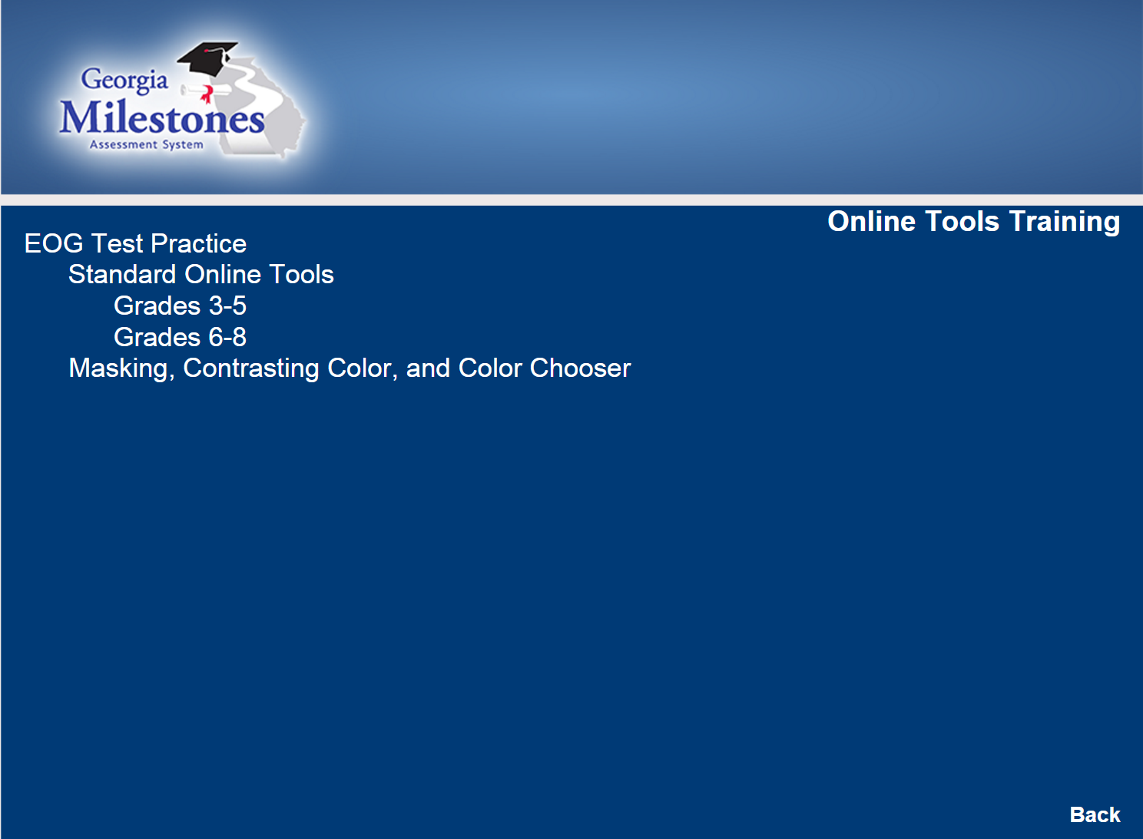

Slide 62
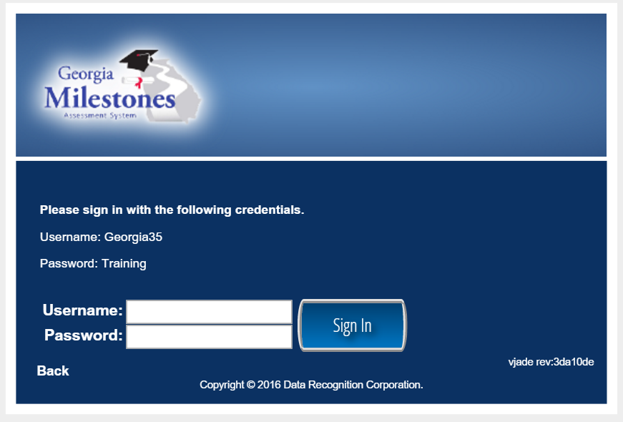

Slide 63
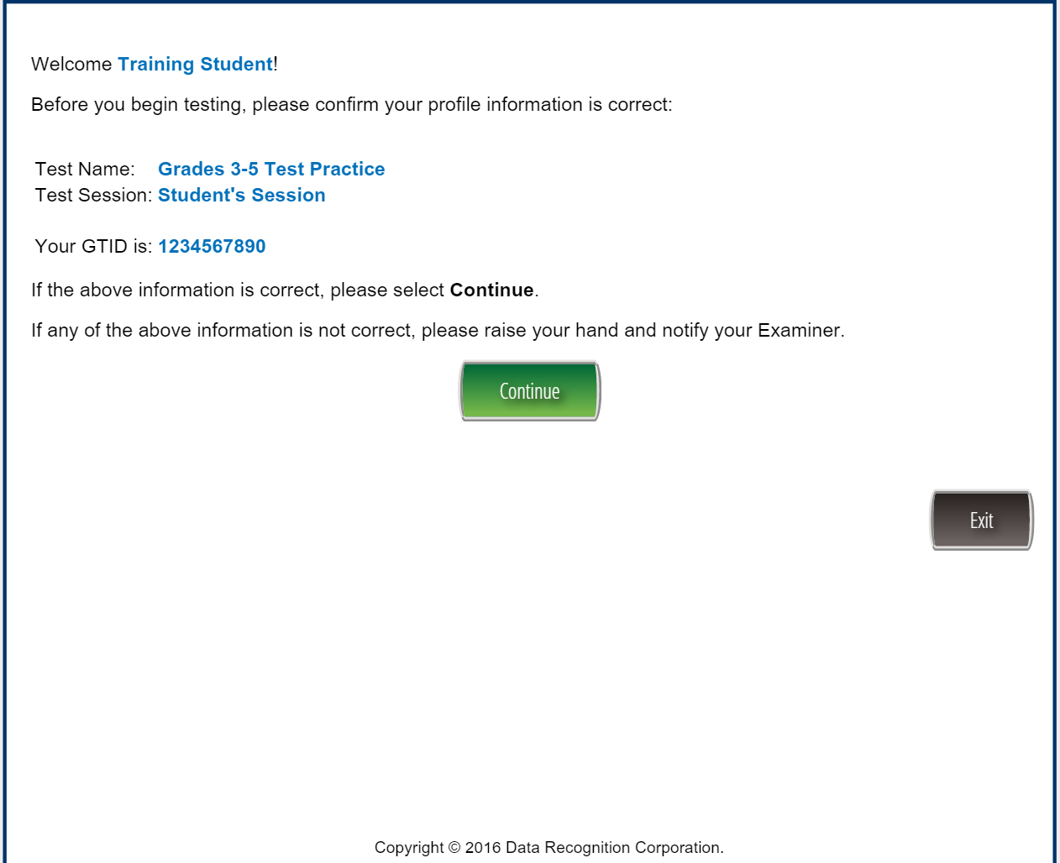

Slide 64
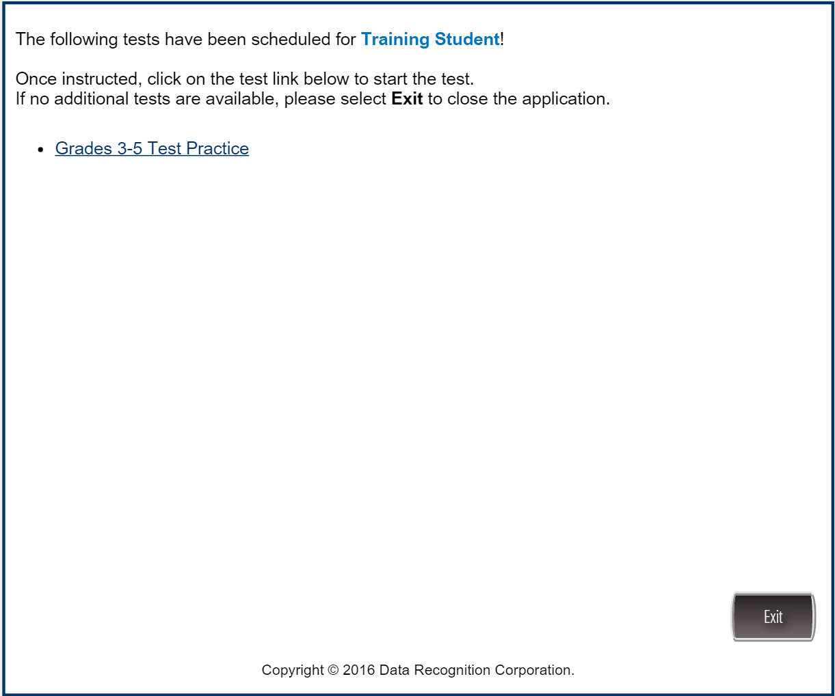

Slide 65
Points of Contact
Alternative Mr. L. Fryer (706) 796-4965 fryerla@richmond.k12.ga.us
Bayvale Mrs. V. Nixon (706) 737-7320 nixonva@richmond.k12.ga.us
Jenkins-White Mrs. D. Murphy (706) 737-7255 murphdi@richmond.k12.ga.us
Josey Mr. D. Palmer (706) 737-7360 palmede@richmond.k12.ga.us
Murphy Mrs. R. Jennings (706) 737-7350 jennire@richmond.k12.ga.us
PLC Mr. L. Fryer (706) 796-4965 fryerla@richmond.k12.ga.us
Wheeless Mrs. T. Williams (706) 796-4985 willith@richmond.k12.ga.us
Wilikinson Garden Mrs. R. Thompson (706) 737-7219 thompra@fichmond.k12.ga.us
Wilkinson
Wheeless
Jenkins White
Alternative
T. W. Josey
Garden

Slide 66
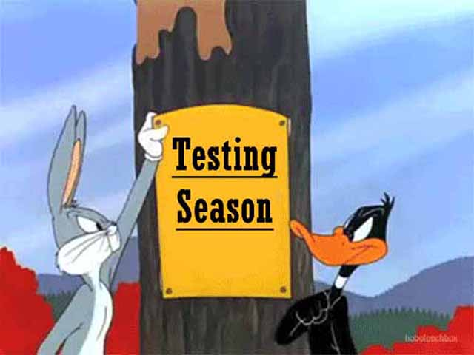

Georgia Milestones 2016:
Let’s Experience Online Testing!

Slide 67
CLOSING
Georgia Milestones Assessment Training
QUESTIONS?
Survey
T. W. Josey
Wilkinson
Alternative
Gardens
Wheeless
Jenkins White

